Slide 1
JAVA 0. HAFTA
Algorithms
FOURTH EDITION
Robert Sedgewick and Kevin Wayne
Princeton University

Slide 2
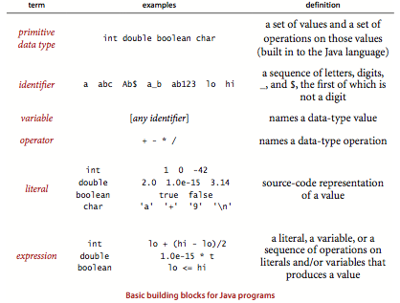
Primitive data types and expressions
Data Type??
int, double, boolean, char

Slide 3
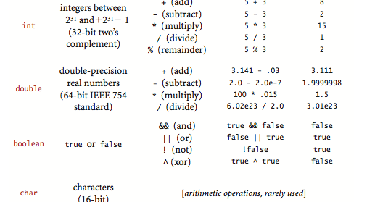
Primitive DataTypes in JAVA

Slide 4
Operators
Expressions Precedence
* and / ( and %) have higher precedence than (are applied before) the + and - operators;
! is the highest precedence, followed by && and then ||.
use parentheses to override these rules

Slide 5
Type Conversion
Numbers are automatically promoted to a more inclusive type if no information is lost.
1 + 2.5, the 1 is promoted to the double value 1.0
Cast: Type name in parentheses
(int) 3.7 →3 , (double) 3 is 3.0.

Slide 6
Comparisons
The following operators compare two values of the same type and produce a boolean value
equal (==), not equal (!=), less than (<), less than or equal (<=), greater than (>), and greater than or equal (>=).

Slide 7
Other Primitives
Java int has 2³² (many machines have 64-bit words nowadays, but the 32-bit int persists)
Double has 64 bit
64-bit integers, with arithmetic operations (long)
16-bit integers, with arithmetic operations (short)
16-bit characters, with arithmetic operations (char)
8-bit integers, with arithmetic operations (byte)
32-bit single-precision real numbers, again with arithmetic operations (float)

Slide 8
Statements
controlling the flow of execution, often in curly braces,
Decleratoions:
Assingments
Conditionals
Loops
Calls and returns

Slide 9
Declerations
A declaration statement associates a variable name with a type at com- pile time.
Java is said to be a strongly typed language, because the Java compiler checks for consistency (for example, it does not permit us to multiply a boolean and a double)

Slide 10
Assignments
When we write c = a + b in Java, we are not expressing mathematical equality, but are instead expressing an action:
set the value of the variable c to be the value of a plus the value of b.
The left-hand side of an as- signment statement must be a single variable; the right-hand side can be an arbitrary expression that produces a value of the type.

Slide 11
Conditionals
Most computations require different actions for different inputs. One way to express these differences in Java is the if statement:
if (<boolean expression>) { <block statements> }
if (<boolean expression>) { <block statements> } else { <block statements> }

Slide 12
Loops
Many computations are inherently repetitive
while (<boolean expression>) { <block statements> }
Break and continue.
The break statement, which immediately exits the loop
The continue statement, which immediately begins the next iteration of the loop

Slide 13
Shortcut Notations
Initializing declarations.
int i = 1;
Implicit assignments.
i++ i—
The code ++i and --i are the same except that the expression value is taken after the increment/ decrement, not before.
i/=2 → i = i/2

Slide 14
Shortcut Notations (Cont.)
Single-statement blocks.
Curly braces can be omitted
For notation.
for (<initialize>; <boolean expression>; <increment>)
{ <block statements> }

Slide 17
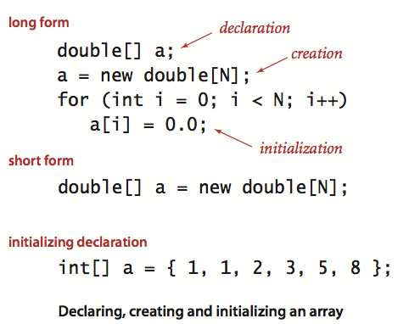
Arrays
An array stores a sequence of values that are all of the same type.
indexing for N value indexing 0 to N-1
a[i] i^{th} value
Creating and initializing an array.
Declare the array name and type.
Create the array. Specify the length
Initialize the array values.

Slide 18
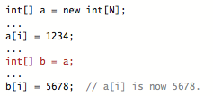
Using an array
Once we create an array, its size is fixed. A program can refer to the length of an array a[] with the code a.length.
Java does automatic bounds checking
ArrayOutOfBoundsException
Note carefully that an array name refers to the whole array if we assign one array name to another, then both refer to the same array,

Slide 19
Two-dimensional arrays
A two-dimensional array in Java is an array of one-dimensional arrays.
A two-dimensional array may be ragged (its arrays may all be of differing lengths),
but we most often work with (for appropriate parameters M and N) M-by-N two-dimensional arrays that are arrays of M rows, each an array of length N (so it also makes sense to refer to the array as having N columns)
two-dimensional array a[][], we use the notation a[i][j]

Slide 20
Two-Dimentional Array
double[][] a = new double[M][N];
double[][] a;
a = new double[M][N];
for (int i = 0; i < M; i++)
for (int j = 0; j < N; j++)
a[i][j] = 0.0;

Slide 22
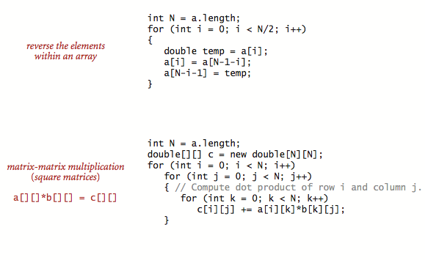

Slide 23
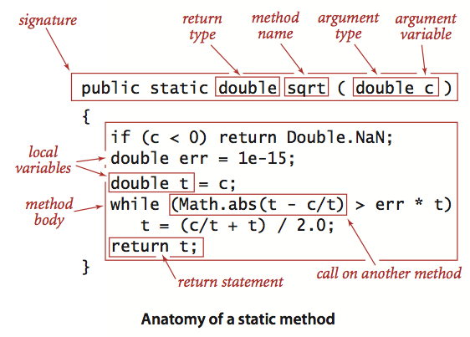
Static methods
Static methods are called functions in many programming languages, since they can behave like mathematical functions,

Slide 24
Defining a static method
A method encapsulates a computation that is defined as a sequence of statements. A method takes arguments (values of given data types) and computes a return value of some data type that depends upon the arguments (such as a value defined by a mathematical function) or causes a side effect that depends on the arguments (such as printing a value)

Slide 26
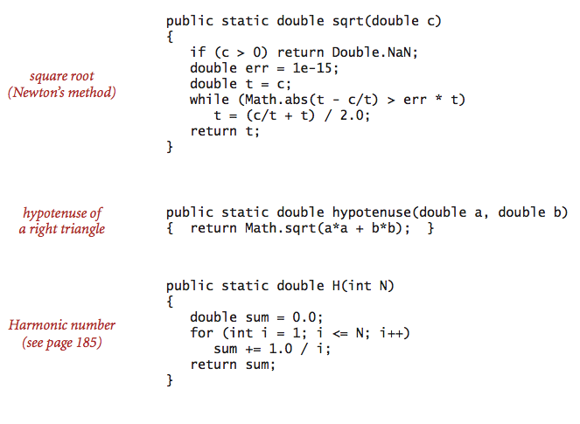

Slide 27
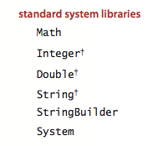
External libraries.
java.lang.*

Slide 28
Strings
A String is a sequence of characters (char values). A literal String is a sequence of characters with in double quotes, such as "Hello, World”
not a primitive type.

Slide 29
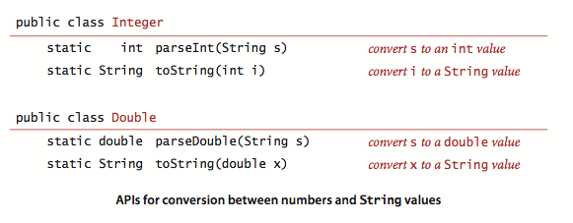
Concatenation
Conversion

Slide 30
Automatic conversion
"The square root of 2.0 is " + Math.sqrt(2.0)

Slide 31
QUESTIONS
Sorting three numbers OF SAME TYPE

Slide 32
DATA ABSTRACTION
So far, we have discussed in detail Java’s primitive data types:
more convenient to write programs at a higher level of abstraction
Programming in Java is largely based on building data types known as reference types with the familiar Java class
This style of programming is known as object-oriented programming, as it revolves around the concept of an object, an entity that holds a data type value.

Slide 33
With primitive → numbers
With reference type → on strings, pictures, sounds etc..
An abstract data type (ADT) is a data type whose representation is hidden from the client .

Slide 34
Using abstract data types
You do not need to know how a data type is implemented in order to be able to use it,

