Slide 1
ESTIMATION TECHNIQUES FOR ANALYZING ENDOGENOUSLY CREATED DATA

Slide 2
Why do we simulate
The reason why one develops a simulation model is because one needs to estimate various performance measures.
These measures are obtained by collecting and analyzing endogenously created data.
we will first discuss briefly how one can collect data generated by a simulation program.

Slide 3
Collecting endogenously created data
reconstruction of the system under investigation.
We have the state of the system as it changes through time.
collect various statistics of interest such as the frequency of occurrence of a particular activity, and the duration of an activity
in the machine interference problem one may be interested in the down time of a machine.
Time the machine spends queueing up for the repairman plus the duration of its repair.
A) Keep track time of arrival at the repairman's queue, and b) time at which the repair was completed.

Slide 4
Keeping in Array
This information can be kept in an array.
at the end the array will simply contain arrival and departure times for all the simulated breakdown
The down time for each breakdown can be easily calculated.
We can Also calculate
Mean
Standart deviaton,
Percentile of downtime

Slide 5
Keeping in link list
Each node contains the following two data elements:
a) time of arrival at the repairman's queue, and b) index number of the machine.
FIFO manner mechines served
The total down time of a machine is calculated at the instance when the machine departs from the repairman. This is equal to the master clock's value at that instance minus its arrival time.
obtain a sample of observations.

Slide 6
Statistical intrest
probability distribution of the number of broken down machines.
the maximum number of broken down machines will not exceed ??
M the total number of machines.
it suffices to maintain an array with m + l locations.
Location i will contain the total time during which there were i broken down machines.
Each time an arrival or a departure occurs, the appropriate location of the array is updated.
At the end of the simulation run, the probability p(n) that there are n machines down is obtained by dividing the contents of the nth location by T, the total simulation time.

Slide 7
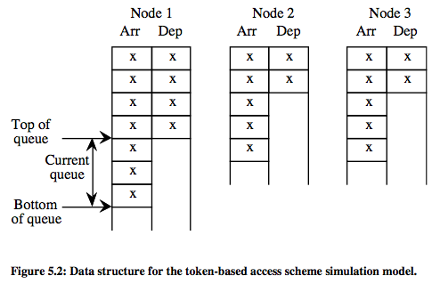
another example
token-based access scheme. each node is associated with a two-dimensional array,
Instead of keeping two columns per node, one can keep one column. When a packet arrives, its arrival time is stored in the next available location. Upon departure of the packet, its arrival time is substituted by its total time in the system.

Slide 8
Transient state vs. steady-state simulation
In general, a simulation model can be used to estimate a parameter of interest during the transient state or the steady state.
The simulation starts by assuming that the system at time zero is at a given state. This is known as the initial condition
The initial condition will affect the behavior of the system for an initial period of time, say T.
Thereafter, the simulation will behave statistically in the same way whatever the initial condition.
During this initial period T, the simulated system is said to be in a transient state. After period T is over, the simulated system is said to be in a steady state.

Slide 9
Transient-state simulation
one is mostly interested in analyzing problems associated with a specific initial starting condition.
one may be forced to study the transient state of a system, if this system does not have a steady state. Such a case may arise when the system under study is constantly changing.

Slide 10
Steady-state simulation
the simulation model has to run long enough so that to get away from the transient state.
There are two basic strategies for choosing the initial conditions
Empty System
as representative as possible of the typical states
Two methods are commonly used to remove the effects of the transient period
The first one requires a very long simulation run,
no data collection is carried out during the transient period.
The problem of determining when the simulation system has reached its steady state is a difficult one.

Slide 11
Determining transient state
simple method involves trying out different transient periods T1,T2,T3,...,Tk, where T1<T2<T3<...<Tk.
Compile steady-state statistics for each simulation run. Choose Ti so that for all the other intervals greater than Ti, the steady- state statistics do not change significantly.
Another similar method requires to compute a moving average of the output and to assume steady-state when the average no longer changes significantly over time.

Slide 12
Estimation techniques for steady-state simulation
probability distribution of an endogenously created random variable.
MOST SOUGHT mean and the standard deviation of a random variable
However, percentiles can be very useful too.
may be interested in the 95% percentile of the down time.
This is the down time such that only 5% of down times are greater than it. Percentiles often are more meaningful to the management than the mean down time.

Slide 13
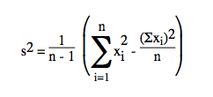
Estimation of the confidence interval of the mean of a random variable
x1, x2,..., xn be n consecutive endogenously obtained observations of a random variable.
Mean
estimate the standard deviation. Shurt cut formula

Slide 14
Confidence interval
%95 confidence interval
The confidence interval provides an indication of the error associated with the sample mean
It is a very useful statistical tool and it should be always computed. Unfortunately, quite frequently it is ignored.
The confidence interval tells us that the true population mean lies within the interval 95% of the time.
That is, if we repeat the above experiment 100 times, 95% of these times, on the average, the true population mean will be within the interval.

Slide 15
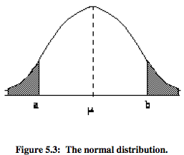
Theory behind the confidence interval
Observations x1, x2, ...xn are assumed to come from a population known as the parent population whose mean μ we are trying to estimate. Let σ² be the variance of the parent population.
The distribution that x follows is known as the sampling distribution
Using the Central Limit Theorem we have that x follows the normal distribution Now, let us fix points a and b in this distribution so that 95% of the observations

Slide 16
http://www.mathsisfun.com/data/standard-normal-distribution-table.html
Using the table of the standard normal distribution, we have that a is 1.96 standard deviation below
Now, if we consider an arbitrary observation mean(x) , this observation will lie in the interval [a,b] 95% of the time.
If the sample size is small (less than 30), then we can construct similar confidence intervals, but points a and b will be obtained using the t distribution,

Slide 17
Central limit theorem
In probability theory, the central limit theorem (CLT) states that, given certain conditions, the arithmetic mean of a sufficiently large number of iterates of independent random variables, each with a well-defined expected value and well-defined variance, will be approximately normally distributed.[1]
That is, suppose that a sample is obtained containing a large number of observations, each observation being randomly generated in a way that does not depend on the values of the other observations, and that the arithmetic average of the observed values is computed.
If this procedure is performed many times, the computed average will not always be the same each time; the central limit theorem says that the computed values of the average will be distributed according to the normal distribution (commonly known as a "bell curve").
http://en.wikipedia.org/wiki/Central_limit_theorem

Slide 18
Correlations
In general, the observations x1, x2,..., xn that one obtains endogenously from a simulation model are correlated. For instance, the down time of a machine depends on the down time of another machine that was ahead of it in the repairman's queue.
In the presence of correlated observations, Expression for the variance does not hold.
Expression for the mean holds for correlated or uncorrelated observations. The correct procedure, therefore, for obtaining the confidence interval of the sample mean is to first check if the observations x1, x2,..., xn are correlated. If they are not, one can
proceed as described above. If the observations are correlated, then one has to use a special procedure to get around this problem.

Slide 19
Correlated Data Observation
Estimation of the autocorrelation function.
Batch means.
Replications.
Regenerative method.

Slide 20
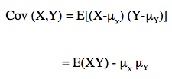
Estimation of the autocorrelation coefficients
Let X and Y be two random variables
Expectectaion μX =X, μY=Y
Covariance
Correlation -1<pxy<1

Slide 21
Covariance
In probability theory and statistics, covariance is a measure of how much two random variables change together.
covariance is positive if directly proportional
covariance is negative if indirectly proportional
If x and y uncorrelated then Cov(X, Y)
If x y identical

Slide 22
Example Autocorrealtion
Now, let us assume we have n observations x1, x2, ..., xn.
(x1,x2), (x2,x3), (x3,x4), ..., (xi,xi+1), ..., (xn-1,xn). Now, let us regard the first observation in each pair as coming from a variable X and the second observation as coming from a variable Y.
Then, in this case ρXY is called the autocorrelation or the serial correlation coefficient.
^{For n reasonably large, ρ}_{XY} ^{can be approximated by}

Slide 23
Autocorrelation Lag 1
above estimate of ρXY as r1
distance of 1 apart
This auto- correlation is often referred to as lag 1 autocorrelation
lag k autocorrelation

Slide 24
Estimation of other statistics of a random variable

Slide 25
In practice,
the autocorrelation coefficients are usually calculated by computing the series of autocovariances R0, R1, ..., where Rk is given by the formula R0 = σ2
rk is not calculated for values of k greater than about n/4.

Slide 26
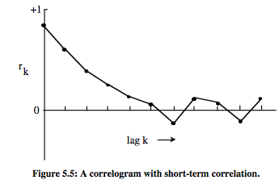
correlogram
A useful aid in interpreting the autocorrelation coefficients is the correlogram. This is a graph in which r_{k} ^{is plotted against lag k.}

Slide 27
Having obtained a sample of n observations x1,x2,...,xn, we calculate the autocorrelation coefficients
Then, the variance can be estimated using the expression

Slide 28
Batch means
It involves dividing successive observations into batches
Each batch contains the same number of observations. Let the batch size be equal to b.
Let Xi be the sample mean of the observations in batch i.
If we choose b to be large enough, then the sequence X1, X2
, ..., Xk can be shown that it is approximately uncorrelated

Slide 29
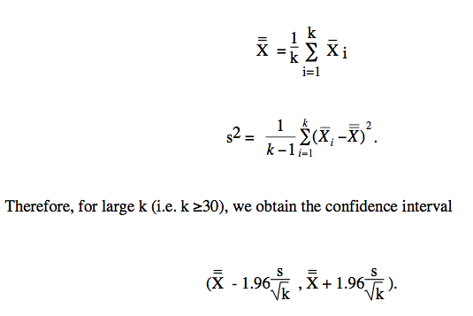

Slide 30
b the bath size
An estimate of b can be obtained by plotting out the correlogram of the observations x1,x2,...,xn, which can be obtained from a preliminary simulation run. We can fix b so
that it is 5 times the smallest value b' for which rb' is approximately zero.

Slide 31
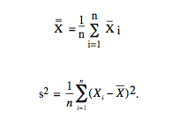
Replications
Another approach to constructing a confidence interval for a mean is to replicate the simulation run several times.
replication 1: x11, x12, ..., x1m
replication 2: x21, x22, ..., x2m
Replication n: xn1, xn2, ..., xnm
Sample mean
We can treat the sample means X1, X2 as a sample of indipendent observations

Slide 32
The problems that arise with this approach
are:
a) decide on the length of each simulation run, i.e., the value m, and
b) decide on the length of the transient period.
One of the following two approaches can be employed:
Start each simulation run with different values for the seeds of the random number generators.
Allow the simulation to reach its steady state and then collect the sample observations.

Slide 33
Alternatively, we can run one very long simulation. Allow first the simulation to reach its steady state, and then collect the first sample of observations. Subsequently, instead of terminating the simulation and starting all over again, we extend the simulation run in order to collect the second sample of observations, then the third sample and so on.

Slide 34
Regenerative method
The last two methods described above can be used to obtain independent or approximately independent sequences of observations.
The method of independent replications generates independent sequences through independent runs.
The batch means method generates approximately independent sequences by breaking up the output generated in one run into successive subsequences which are approximately independent.

Slide 35
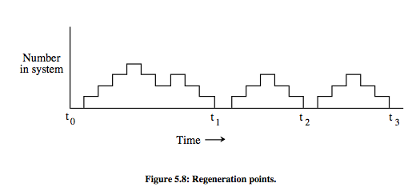
Regeneration cycle, Tour
All regeneration cycles are assumed to be indipendent from previous cycles

Slide 36
Estimation of other statistics of a random variable
Other interesting statistics related to the probability distribution of a random variable are:
Probability that a random variable lies within a fixed interval.
Percentiles of the probability distribution.
Variance of the probability distribution.

Slide 37
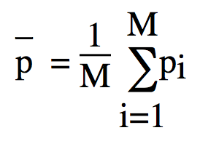
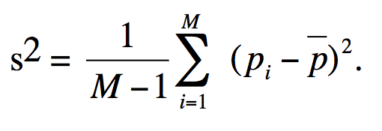
Probability that a random variable lies within a fixed interval
The estimation of this type of probability can be handled exactly the same way as the estimation of the mean of a random variable
Let I be the designated interval. We want to estimate p = Pr (X ∈ I) where X is an endogenously created random variable
generate M replications of the simulation
For each replication i we collect N observations of X.
Let vi be the number of times X was observed to lie in I.
Then, pi = vi/N is an estimate of probability p. Thus,

Slide 38
We observe, that the estimation of p requires M independent replications, each giving rise to one realization of p
instead of replications, the batch means method or the regenerative method can be used.

Slide 39
Percentile of a probability distribution
It sometimes, is not interested in the mean of a particular random variable
For instance, the person in charge of a web service may not be interested in its mean response time. Rather, he or she may be interested in "serving as many as possible as fast as possible"
More specifically, he or she may be interested in knowing the 95th percentile of the response time.

Slide 40
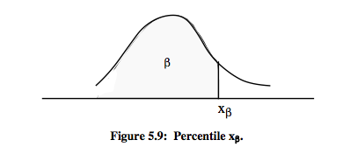
Example
let us consider a probability density function f(x).
The 100βth percentile is the smallest value xβ such that
f(xβ) < β
Typically, there is interest in the 50th percentile (median) x0.50 or in extreme percentiles such as x0.90, x0.95, x0.99.

Slide 41
We are interested in placing a confidence interval on the point estimator of xβ of a distribution of a random variable X. Let us assume independent replications of the simulation
Each replication yields N observations having allowed for the transient period.
For each replication i, let xi1, x12, ..., x1N be the observed realizations of X.
Now, let us consider a reordering of these observations yi1, y12, ..., y1N so that yij<yi,j+1
Then, the 100βth percentile x ( i ) for the ith replication is observation y_{ik}
where k=Nβ, if Nβ is an integer, or k= #Nβ$+1 if Nβ is not an integer

Slide 42
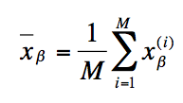
For instance, if we have a sample of 50 observations ordered in an ascending order, then the 90th percentile is the observation number 0.90.50 = 45. The 95th percentile is 50x0.95+1= 47.5+1=47+1=48.
Confidence intervals can now be constructed in the usual manner.

Slide 43
The estimation of extreme percentiles requires long simulation runs. If the runs are not long, then the estimates will be biased.
The calculation of a percentile requires that
a) we store the entire sample of observations until the end of the simulation, and
b) that we order the sample of observations in an ascending order.
These two operations can be avoided by constructing a frequency histogram of the random variable on the fly. When a realization of the random variable becomes available, it is immediately classified into the appropriate interval of the histogram.
Finally, we note that instead of independent replications of the simulation, other methods can be used such as the regeneration method.

Slide 44
Variance of the probability distribution
Let us consider M independent replications of the simulation. From each replication i we obtain N realizations of a random variable xi1,xi2,...,xiN, after we allow for the transient period

Slide 45
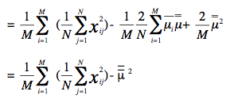
The estimates of si² are all function of Thus they are not indipendent. Confidence interval can be constructed by jacknifing the estimator s²

Slide 46
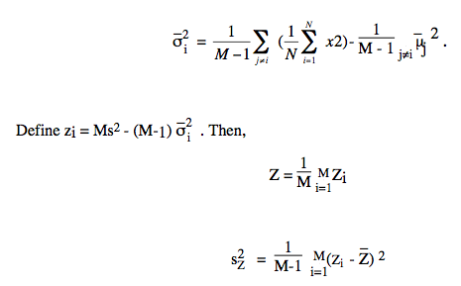
and a confidence interval can be constructed in the usual way

Slide 47
Alternatively
we can obtain a confidence interval of the variance by running the simualtion only once, rather than using repications, and then calculating the standard deviation assuming that the successive observations are independent!
This approach is correct when the sample of observations is extremely large.

Slide 48
Estimation techniques for transient-state simulation
The statistical behaviour of a simulation during its transient state depends on the initial condition.
In order to estimate statistics of a random variable X during the transient state one needs to be able to obtain independent realizations of X
The only way to get such independent observations is to repeat the simulation.
Each independent simulation run has to start with the same initial condition.

Slide 49
Pilot experiments and sequential procedures for achieving a required accuracy
SO FAR : generating confidence intervals for various statistics of an endogenously generated random variable.
The expected width of the confidence interval is,
What should be the N size If we want to halve the width of the confidence interval.
What is the size for N
Typically, this problem is tackled by conducting a pilot experiment.
This experiment provides a rough estimate of the value of N that will yield the desired confidence interval width.
An alternative approach is the sequential method. That is, the main simulation experiment is carried out continuously.

Slide 50
Computer Assignments

Slide 51
Nice to remmember
Definition of Expected Value
Let f(x) be a probability density function on the domain [a,b], then the expected value of f(x) is
Definition of Variance and Standard Deviation
Let f(x) be a probability density function on the domain [a,b], then the variance of f(x) is and the standard deviation is the square root of the variance.

Slide 52
Definition of the Median
Let f(x) be a probability density function on the domain [a,b], then the median of f(x) is the unique number m between a and b such that
Normal Distrubution and Exponential distrubution

