Slide 1
GENERATING STOCHASTIC VARIATES

Slide 2
we discuss techniques for generating random numbers with a specific distribution
Random numbers following a specific distribution are called random variates or stochastic variates

Slide 3
The inverse transformation method
This method is applicable only to cases where the cumulative density function can be inversed analytically.
CDF?
The proportion of population with value less than x
• The probability of having a value less than x

Slide 4
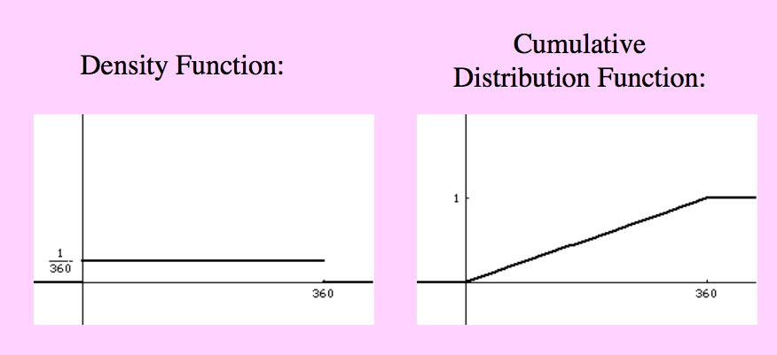
CDF

Slide 5
The inverse transformation method
We wish to generate a stochastıc varieties, from a PDF f(x)
F(x) cdf [0, 1]
FIRST generate random s= F(x)
x=F⁻¹(r)

Slide 6
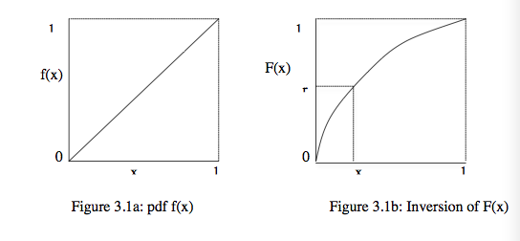
Example
We want to generate random variates with probability density function
f(x)=2x, 0≤x≤1
=x² 0≤x≤1 ,
Let r be a random number. We have
r=x^{2,}

Slide 7
Sampling from continuous-time probability distributions
We will use invers transform technique to generate variates from a
uniform distribution,
an exponential distribution, and
an Erlang distribution.

Slide 8
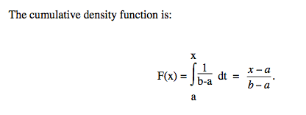
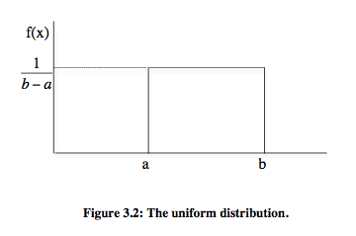
Sampling from a uniform distribution
probability density function

Slide 9
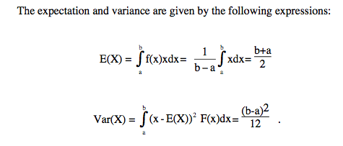
Unifrom Cont.
d

Slide 10
Varyans nedir
Olasılık kuramı ve istatistik bilim dallarında varyans
bir rassal değişken, bir olasılık dağılımı veya örneklem için istatistiksel yayılımın,
mümkün bütün değerlerin
beklenen değer veya ortalamadan uzaklıklarının karelerinin ortalaması şeklinde bulunan bir ölçüdür
Ortalama bir dağılımın merkezsel konum noktasını bulmaya çalışırken, varyans değerlerin ne ölçekte veya ne derecede yaygın olduklarını tanımlamayı hedef alır.
Varyans için ölçülme birimi orijinal değişkenin biriminin karesidir. Varyansın kare kökü standart sapma olarak adlandırılır; bunun ölçme birimi orijinal değişkenle aynı birimde olur ve bu nedenle daha kolayca yorumlanabilir.

Slide 11
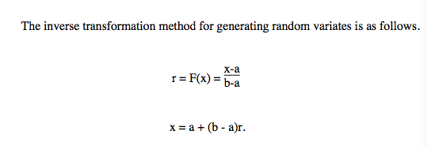
Inverse CDF
sd

Slide 12
Sampling from an exponential distribution
The probability density function of the exponential distribution is defined as follows:
Cumulative Density Function

Slide 13
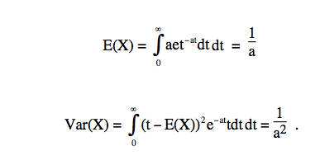
Exponantial Dist.
expectation and variance are given

Slide 14
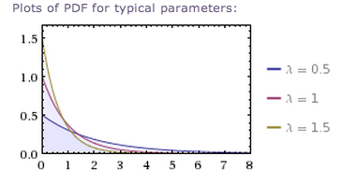
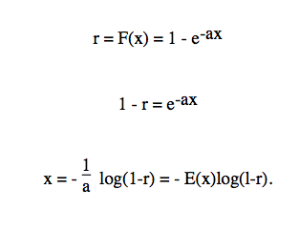
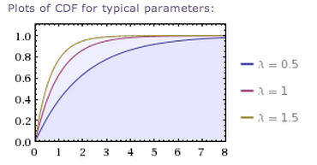
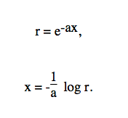
INVERSE TRANS.
Since 1-F(x) is uniformly distributed in [0,1], we can use the following short-cut procedure

Slide 15
Agner Krarup Erlang
Agner Krarup Erlang (1 January 1878 – 3 February 1929) was a Danish mathematician,statistician and engineer, who invented the fields of traffic engineering and queueing theory.
By the time of his relatively early death at the age of 51, Erlang created the field of telephone networks analysis. His early work in scrutinizing the use of local, exchange and trunk telephone line usage in a small community to understand the theoretical requirements of an efficient network led to the creation of the Erlang formula, which became a foundational element of present day telecommunication network studies.

Slide 16
Sampling from an Erlang distribution
In many occasions an exponential distribution may not represent a real life situation
execution time of a computer program,
manufacture an item
It can be seen, however, as a number of exponentially distributed services which take place successively
If the mean of each of these individual services is the same, then the total service time follows an Erlang distribution

Slide 17
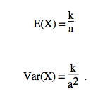
Erlang
The Erlang distribution is the convolution of k exponential distributions having the same mean 1/a
An Erlang distribution consisting of k exponential distributions is referred to as E_{k}
The expected value and the variance of a random variable X that follows the Erlang distribution are:

Slide 18
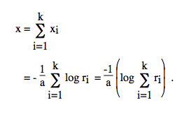
Erlang variates may be generated by simply reproducing the random process on which the Erlang distribution is based.
This can be accomplished by taking the sum of k exponential variates, x1, x2, ..., xk with identical mean 1/a.

Slide 19
Sampling from discrete-time probability distributions
Geometric Distribution
Binomial Distribution
Poisson Distribution

Slide 20
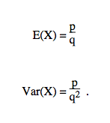
Geometric Distribution
Consider a sequence of independent trials, where the outcome of each trial is either a failure or a success.
Let p and q be the probability of a success and failure respectively. We have that p+q=1.
The random variable that gives the number of successive failures that occur before a success occurs follows the geometric distribution
PDF Expectation
CDF Variance

Slide 21
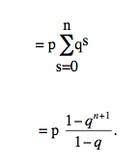
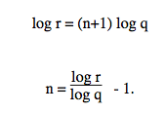
Applying Inverse Transform to obtain geometric variates
since p=1-q =>
F(n)=1-q^{n+1}
1-F(n)=q^{n+1}
Since 1-F(n) changes [0,1] let r be random number
r=q^{n+1} (take inverse of CDF)

Slide 22
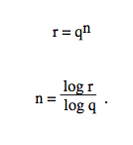
Alternatively
since (1-F(n))/q=q^{n}, and (1-F(n))/q varies between 0 and 1

Slide 23
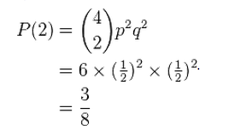
Recap Bernoulli trials
In the theory of probability and statistics, a Bernoulli trial (or binomial trial) is a random experiment with exactly two possible outcomes, "success" and "failure", in which the probability of success is the same every time the experiment is conducted.
A random variable corresponding to a binomial is denoted by B(n, p), and is said to have a binomial distribution. The probability of exactly k successes in the experiment B(n, p) is given by:
For a fair coin the probability of exactly two tosses out of four total tosses resulting in a heads is given by:

Slide 24
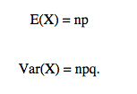
Sampling from a binomial distribution
Consider a sequence of independent trials (Bernoulli trials).
expectation and variance of the binomial distribution are:

Slide 25
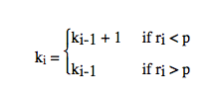
Cont.
We can generate variates from a binomial distribution with a given p and n as follows.
We generate n random numbers, after setting a variable k₀ equal to zero. For each random number ri, i=1, 2, ..., n, a check is made, and the variable k_{i} is incremented as follows:
The final quantity kn is the binomial variate. This method for generating variates is known as the rejection method.

Slide 26
Sampling from a Poisson distribution
The Poisson distribution models the occurrence of a particular event over a time period.
Let λbe average of number of occurrence during a unit time. Then, the number of occurrence x during a unit period has the following probability density function
P(n)=e^{-λ}(λ^{n} /n!) n=0, 1, 2, …
it can be demonstrated that the time elapsing between two successive occurrences of the event is exponentially distributed with mean 1/λ, f(t)=λ e^{-λt}

Slide 27
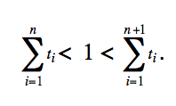
Poisson Variates
One method for generating Poisson variates involves the generation of exponentially distributed time intervals
t1, t2, t3,...
with an expected value equal to 1/λ.
These intervals are accumulated until they exceed 1, the unit time period. That is,

Slide 28
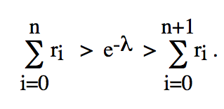
The Stochastic variates n simply the number of events occurred during a unit time period. Now,
since ti = -1/λ log r_{i}
, n can be obtained by simply summing up random numbers until the sum for n+1 exceeds the quantity e^{-λ}. That is, n is given by the following expression:

Slide 29
Sampling from an empirical probability distribution
Quite often an empirical probability distribution may not be approximated satisfactorily by one of the well-known theoretical distributions. In such a case, one is obliged to generate variates which follow this particular empirical probability distribution. In this section, we show how one can sample from a discrete or a continuous empirical distribution.

Slide 30
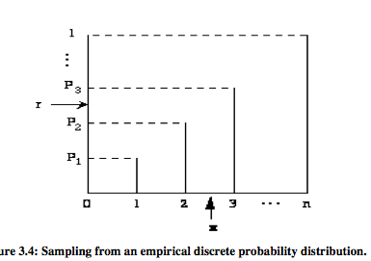
Sampling from a discrete-time probability distribution
Let X be a discrete random variable,
p(X = i) = pi, where pi is calculated from empirical data.
Let p(X≤i) = Pi be the cumulative probability
Let r be a random number , r falls between P2 and P3
the random variate
x is equal to 3.
if Pi-1<r<Pi then x=i.
This method is based on the fact that p_{i}=P_{i}-P_{i-1} and
that since r is a random number, it will fall in the interval (Pi, Pi-1) pi% of the time.

Slide 31
Example
let us consider the well-known newsboy problem. Let X be the number of newspapers sold by a newsboy per day. From historical data We have,
The cumulative probability distribution is:

Slide 32
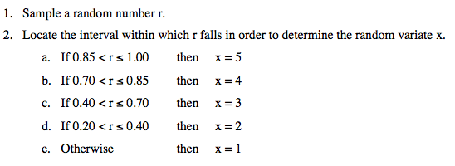

Slide 33
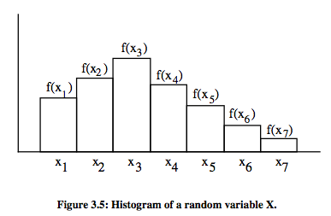
Sampling from a continuous-time probability distribution
Let us assume that the empirical observations of a random variable X can be summarized into the histogram
xi is the midpoint of the ith interval, and f(xi) is the length of the ith rectangle.
approximately construct the cumulative probability distribution

Slide 34
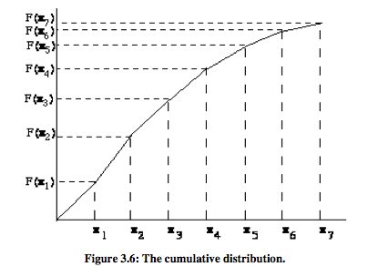
The cumulative distribution is assumed to be monotonically increasing within each interval [F(xi-1), F(xi)].

Slide 35
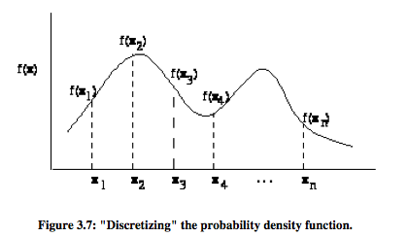
Let r be a random number and let us assume that F(xi-1)<r<F(xi). Then, using linear interpolation, the random variate x can be obtained as follows:
http://en.wikipedia.org/wiki/Linear_interpolation

Slide 36
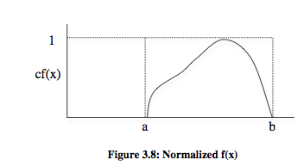
The rejection method
The rejection technique can be used to generate random variates, if f(x) is bounded and x has a finite range, say a ≤ x ≤ b. The following steps are involved:
1. Normalize the range of f(x) by a scale factor c so that cf(x)≤1,a≤x≤b. (See figure 3.8)
2. Define x as a linear function of r, i.e. x = a + (b-a) r, where r is a random number.
3. Generate pairs of random numbers (r₁^{, r}₂^{).}
4. Accept the pair and use x = a + (b-a)r₁ as a random variate whenever the pair
^{satisfies the relationship r}₂ ^{≤ cf(a + (b-a)r}₁^{), i.e. the pair (x,r}₂) falls under the curve in figure 3.8.

Slide 37
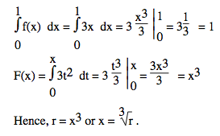
Problem
Use the inverse transformation method to generate random variates with probability density function

Slide 38
Problem2
Apply the inverse transformation method and devise specific formulae that yield the value of variate x given a random number r. (Note that f(x) below needs to be normalized.)

Slide 39
Sampling from a normal distribution
A random variable X with probability density function

Slide 40
Bibliography
http://www.math.vt.edu/people/qlfang/class_home/Lesson2021.pdf CDF
http://en.wikipedia.org/wiki/Agner_Krarup_Erlang
http://tr.wikipedia.org/wiki/Varyans
http://en.wikipedia.org/wiki/Bernoulli_trial

