Slide 1
Generating Random Numbers

Slide 2
THE GENERATION OF PSEUDO-RANDOM NUMBERS
Agenda
generating random number uniformly distributed
Why they are important in simulation

Slide 3
Why important in General
Numerical analysis,
random numbers are used in the solution of complicated integrals.
In computer programming,
random numbers make a good source of data for testing the effectiveness of computer algorithms.
Cryptography
Random numbers also play an important role in cryptography.

Slide 4
Why it is important in Simulation
random numbers are used in order to introduce randomness in the model.
In Machine interference Simulation model we assumed constant for most of TIMES (repair time, operational time) that is not the case in general
If we are able to observe the operational/repair times of a machine over a reasonably long period, we will find that they are typically characterized by a theoretical or an empirical probability distribution.
THEREFORE we should randomly fallow a theoretical or an empirical probability distribution
Hence we need uniformly distributed random numbers, to produce random variates or stochastic variates

Slide 5
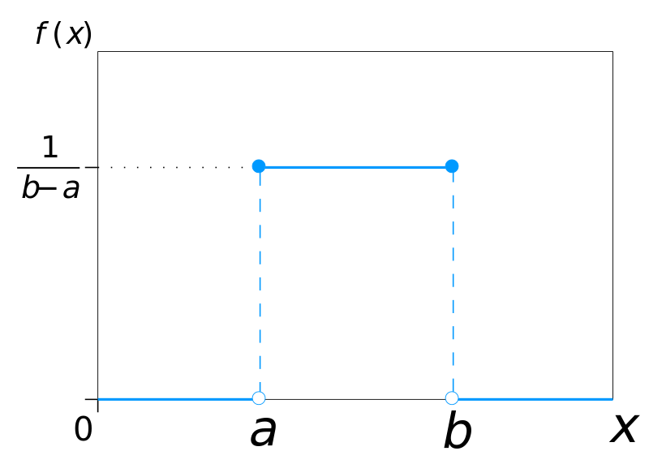
Recap.. Uniform distribution
each member of the family, all intervals of the same length on the distribution's support are equally probable. FIGURE SHOWS THE PDF

Slide 6
Pseudo-Random Numbers
there is no such a thing as a single random number
we speak of a sequence of random numbers that follow a specified theoretical or empirical distribution
To generate
physical phenomenon (true random)
Unpredictable non reproducible, natural software hardware
Thermal noise of a diode, radioactive decay
ideal for cryptography, not good for simulation WHY?
We need to reproduce the same random numbers

Slide 7
To Generate (cont.)
TO mathematical algorithms
produce numbers in a deterministic fashion.
Start value Seed
these numbers appear to be random since they pass a number of statistical tests designed to test various properties of random numbers
Therefore they are referred to as pseudo-random numbers.
DEBUG
on demand generation no need to store
uniformly distributed in the space [0, 1]
ALTERNATIVE to pseudo-random numbers???

Slide 8
Rule of thumb for accepting random numbers
generating random numbers must yield sequences of numbers or bits that are:
uniformly distributed
statistically independent
reproducible, and
non-repeating for any desired length.

Slide 9
Methods
The congruential method
This is a very popular method and most of the available computer code for the generation of random numbers use some variation of this method.
Simple Fast Acceptable
xi, a, c and m are all non-negative numbers.
mixed congruential method.
between 0, m-1, Normalizing them [0, 1] divide by m
if x0 = 0, a = c = 7, and m = 10 then we can obtain the following sequence of numbers: 7, 6, 9, 0, 7, 6, 9, 0,...

Slide 10
Period
The number of successively generated pseudo-random numbers after which the sequence starts repeating itself is called the period.
If the period is equal to m, then the generator is said to have a full period
Theorems from number theory show that the period depends on m. The larger the value of m, the larger is the period.

Slide 11
guarantee a full period:
In particular, the following conditions on a, c, and m guarantee a full period:
m and c have no common divisor.
a=1(mod r)if r is a prime factor of m. That is, if r is a prime number(divisible only by itself and 1) that divides m, then it divides a-1.
a = 1 (mod 4) if m is a multiple of 4.
Example Set of
A set of such values is: a = 314, 159, 269, c = 453, 806, 245, and m = 2^32 (for a 32 bit machine).

Slide 12
A question ??????
pseudo-random number generator involves a multiplication, an addition and a division.
How can we avoid division??
by setting m equal to the size of the computer word
What if an overflow occurs
We lose only the significant bit which is multiple of m remaining is the remainder
To demonstrate m=100 max number Is 99
If a=8, x=2 c=10 result is 26
If x=20 result is axi+c=170 but remainder 70

Slide 13
General congruential methods
General congruential
f(.) is a function of previously generated pseudo-random numbers. A special case of the above general congruential method is the quadratic congruential generator.
Special Case a1=a2=1 c=0 m is power of 2

Slide 14
Composite generators
We can develop composite generators by combining two separate generators (usually congruential generators). By combining separate generators, one hopes to achieve better statistical behavior than either individual generator.
One of the good examples for this type of generator uses the second congruential generator to shuffle the output of the first congruential generator

Slide 15
Tausworthe generators
Tausworthe generators are additive congruential generators obtained when the modulus m is equal to 2 to produce bıt streams
ai are binary
They are too slow since they only produce bits
trinomial-based Tausworthe generator

Slide 16
The lagged Fibonacci generators
based on the well-known Fibonacci sequence,
General form of LFG
where 0<j<k, and appropriate initial conditions have been made.
combining two previously calculated elements that lag behind the current element utilizing an algebraic operation O.
addition, or a subtraction, or a multiplication as well as it can be a binary operation XOR.
additive LFG (ALFG). multiplicative LFG (MLFG).

Slide 17
Mersanne Twister

Slide 18
Statistical tests for pseudo-random number generators
Not all random-number generators available through programming languages and other software packages have a good statistical behavior.
RANDOMNESS OF SEQUENCE OF BITS
frequency test,
serial test,
autocorrelation test,
GOODNESS OF FIT
runs test, and
chi-square test for goodness of fit.

Slide 19
Frequency test (Monobit test)
the most fundamental test
In a true random sequence, the number of 1’s and 0’s should be about the same
This test checks whether this is correct or not
complementary error function (erfc) MATLAB , JAVA

Slide 20
HOW TO
Generate m pseudo-random numbers and concatenate them into a string of bits. Let the length of this string be n. The 0’s are first converted into –1’s and then the obtained set of -1 and 1 values are all added up. Let
Compute the test statistic
Compute the P-value Pvalue<0.01 reject

Slide 21
Example
let us consider the bit string: 1011010101.
Then, Sn = 1-1 +1+1- 1+1-1+1-1+1 = 2 and
Sobs=0.6324.
For a level of significance α = 0.01,
we obtain that P- value = erfc(0.6324) = 0.5271 > 0.01.
Thus, the sequence is accepted as being random.

Slide 22
Serial Test
There are 2^{k} different ways of combining k bits. Each of these combinations has the same chance of occurring, if the sequence of the k bits is random. The serial test determines whether the number of times each of these combinations occurs is uniformly distributed.
k=1 it is frequency test
e =sequence of n bits created by a pseudo-random number generator. (recommended min n 100)
The serial statistical test checks the randomness of overlapping blocks of k, k-1, k-2 bits found in e

Slide 23
A statistical testing for pseudorandom number generators for cryptographic applications”, NIST special publication 800-22.

Slide 24
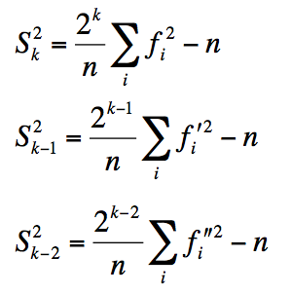
Serial Test
Step1– obtain e1,e2,e3
Augment e by appending its first k-1 bits to the end of the bit string e, and let e₁ be the resulting bit string.
Likewise, augment e by appending its first k-2 bits to the end of the bit string e, and let e₂ be the resulting bit string.
Finally, augment e by appending its first k-2 bits to the end of the bit string e, and let e₃ be the
Step 2 – compute frequency
For sequences e1, e2, e3, in overlap k, k-1, k. frequencies
f_{i}¹,f_{i}² f_{i}³ represent the frequency of occurrence of the i^{th} k, k-1, k-2 overlapping bit combination
Step 3 compute statistics

Slide 25
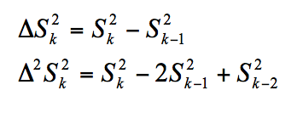
Serial Test
Step 4 –Compute difference statistics
Step 5 Compute P values
Step 6
If P-value1 or P-value2 < 0.01 then we reject the null hypothesis that the sequence is random, else we accept the null hypothesis that the sequence is random. (0.01 is significance level)
As in the frequency test, if the overlapping bit combinations are not uniformly distributed, ΔS ² and Δ² S ² become large that causes the P-values to be small.

Slide 26
Example Serial Test
e = 0011011101, with n=10, and k=3
Step 1
Append the k-1=2 bits e1 = 001101110100.
appending the first k-2=1 e2=00110111010
k-3=0 e3 = e = 0011011101.
Step 2 frequency calculation
For the 3-bit blocks we use e1
For the 2- bit blocks we use e2
For the 1-bit blocks we use e=e3
 |  |  |  | Frequency
C1 | 0 | 0 | 0 | f1 | 0
C2 | 0 | 0 | 1 | f2 | 1
C3 | 0 | 1 | 0 | f3 | 1
C4 | 0 | 1 | 1 | f4 | 2
C5 | 1 | 0 | 0 | f5 | 1
C6 | 1 | 0 | 1 | f6 | 2
C7 | 1 | 1 | 0 | f7 | 2
C8 | 1 | 1 | 1 | f8 | 0
 |  |  | Frequency
C1 | 0 | 0 | f1 | 1
C2 | 0 | 1 | f2 | 3
C3 | 1 | 0 | f3 | 3
C4 | 1 | 1 | f4 | 3
 |  | Frequency
C1 | 0 | f1 | 4
C2 | 1 | f2 | 6

Slide 27
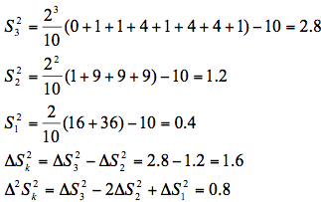
Step3 Compute difference statistics
Step 4 calculate P values
Since both P-value1 and P-value2 are greater than 0.01, this sequence passes the serial test.

Slide 28
Auto Corelations
Let e denote a sequence of n bits created by a pseudo-random number generator. The intuition behind the autocorrelation test is that if the sequence of bits in e is random, then it will be different from another bit string obtained by shifting the bits of e by d positions.

Slide 29
Runs Test
The runs test can be used to test the assumption that the pseudo-random numbers are independent of each other. We start with a sequence of pseudo-random numbers in [0,1]. We then look for unbroken subsequences of numbers, where the numbers within each subsequence are monotonically increasing. Such a subsequence is called a run up, and it may be as long as one number.

Slide 30
Chi-square test for goodness of fit
This test checks whether a sequence of pseudo-random numbers in [0,1] are uniformity distributed. The chi-square test, in general, can be used to check whether an empirical distribution follows a specific theoretical distribution. In our case, we are concerned about testing whether the numbers produced by a generator are uniformly distributed.

Slide 32
BIBLIOGRAPHY
http://en.wikipedia.org/wiki/Uniform_distribution_(continuous)
COMPUTER SIMULATION TECHNIQES HARRY PERROS

