Slide 1
Simulation Design

Slide 2
Types
event-advance and
unit-time advance. Both these designs are event-based but utilize different ways of advancing the time
The third design is activity- based.

Slide 3
Event-advance design
Described in previous weeks
Briefly
The basic idea behind this design is that the status of the system changes each time an event occurs. During the time that elapses between two successive events, the system's status remains unchanged.
it suffices to monitor the changes in the system's status.
In order to implement this idea, each event is associated with a clock.
The value of this clock gives the time instance in the future that this event will occur.
upon completion of processing an event, say at time t1, regroups all the possible events that will occur in the future and finds the one with the smallest clock value.

Slide 4
Cont.
The simulation model, therefore, moves through time by simply visiting the time instances at which events occur.
In the machine interference problem,
Two Type of event
the event of an arrival at the repairman's queue,
and the event of a departure from the repairman's queue.
primary events.
Quite often the occurrence of a primary event may trigger off the creation of a new event.

Slide 5
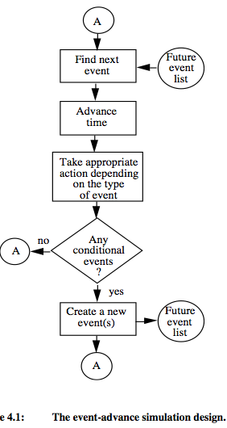
Basic Approach

Slide 6
Future event list
Let us assume that a simulation model is currently at time t.
The collection of all events scheduled to occur in the future, i.e., events with clock greater than t, is known as the future event list.
For instance, in the case of the machine interference problem there were only two: an arrival to the repairman's queue and a service-ending (departure) event.
Naturally, it is important to have an efficient algorithm for finding the next event since this operation may well account for a large percentage of the total computations involved in a simulation program

Slide 7
Propertıes of Event List

Slide 8
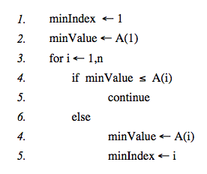
Sequential arrays
all future event times are stored sequentially in an array. The simplest way to implement this, is to associate each event type with an integer number i.
The advantage of storing an event list in a sequential array is that insertions of new events and deletions of caused events can be done very easily

Slide 9
Linked lists
Node
Link next data element of node
each node will consist of two data elements, namely a clock CLi showing the future time of an event, and a value i indicating the type of event. The nodes are arranged in an ascending order so that CLi ≤ CLj ≤ . . . ≤ CLn.

Slide 10
Implementation of a future event list as a linked list

Slide 11
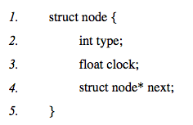
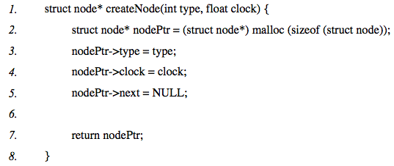
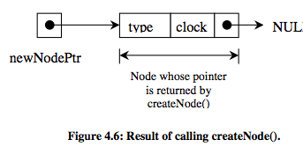
Creating and deleting nodes
the structure can contain other satellite data which may be specific to each event.

Slide 12
Deletion of a node

Slide 13
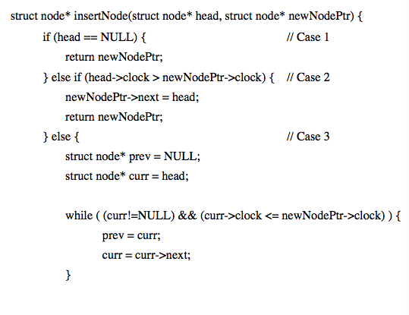
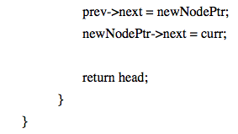
Creating linked lists, inserting and removing nodes
The node can then be inserted into the list in an appropriate position such that the nodes are ordered according to a specified field.

Slide 14
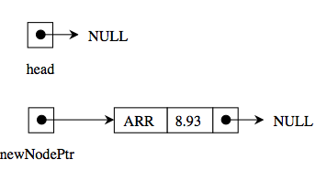
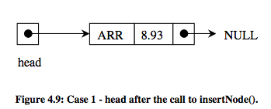
Case 1 head is NULL

Slide 15
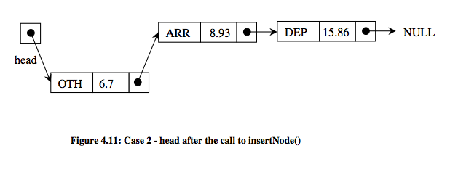
Case 2: head->clock > newNodePtr->clock

Slide 16
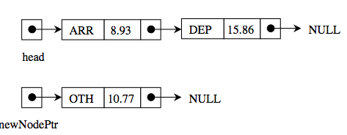
Case 3: Insertion between head and last node of the list

Slide 17
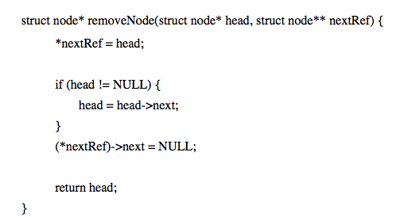
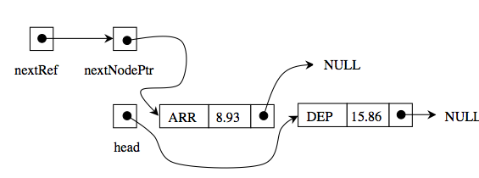
Removing a node from the linked list
The linked list is always maintained in an ascending order of the clock value. Therefore, the next event to occur is the first node of the linked list.

Slide 18
Time complexity of linked lists
Insert / Remove
In order to insert a node in the linked list we have to traverse the linked list and compare each node until we find the correct insertion position
The maximum number of nodes compared in the worst case will be the total number of nodes in the list. Thus the complexity of the insert operation is linear on n.
Searching a linked list might be time consuming if n is very large. In this case, one can employ better searching procedures. For example, a simple solution is to maintain a pointer B to a node which is in the middle of the linked list.

Slide 19
Doubly linked lists

Slide 20
Unit-time advance design
the master clock can be advanced in fixed increments of time, each increment being equal to one unit of time.
Each time the master clock is advanced by a unit time, all future event clocks are compared with the current value of the master clock.
If no clock is equal to the current value of the master clock, then no event has occurred and no action has to take place. In either case, the master clock is again increased by unit time and the cycle is repeated. This mode of advancing the simulation through time

Slide 21
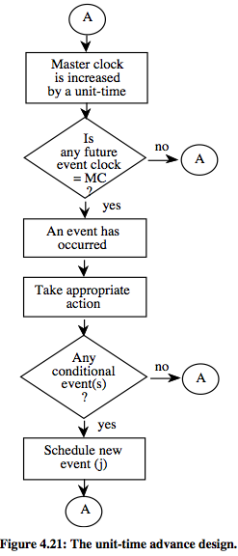

Slide 22
Alternative Future Clock
future event clock is a variable which, as in the case of the vent-advance design, contains a future time with respect to the origin
Alternatively, a future clock can simply reflect the duration of a particular activity.
Each time the master clock is advanced by a unit of time, the value of each future clock is decreased by a unit time. If any of these clocks becomes equal to zero, then the associated event has occurred and appropriate action has to take place.

Slide 23
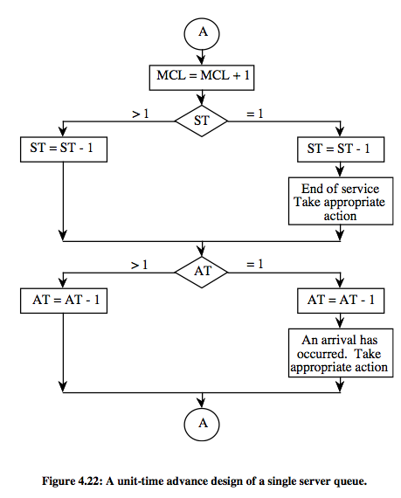

Slide 24
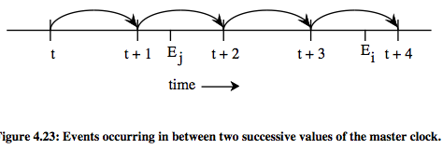
Selecting a unit time
The unit time is readily obtained in the case where all future event clocks are represented by integer variables
For, each event clock is simply a multiple of the unit time.
frequently future event clocks are represented by real variables.

Slide 25
Complications
This introduces inaccuracies when estimating time parameters related to the occurrence of events.
Another complication that might arise is due to the possibility of having multiple events occurring during the same unit of time.
In general, a unit time should be small enough so that at most one event occurs during the period of a unit of time
However, if it is too small, the simulation program will spend most of its time in non-productive mode, i.e. advancing the master clock and checking whether an event has occurred or not.
simple heuristic rule such as setting the unit time equal to one-half of the smallest variate generated.

Slide 26
Cont.
For instance, one can start with a small unit time. Then, it can be slightly increased. If it is found to have no effect on the computed results, then it can be further increased, and so on.

Slide 27
Implementation
The main operation related to the processing of the future event list is to compare all the future event clocks against the master clock each time the master clock is increased by a unit time. An implementation using a sequential.

Slide 28
Event-advance vs. unit-time advance
where there are many events which occur at times close to each other
The best case, in fact, would occur when the events are about a unit time from each other.
The worst case for the unit-time advance method is when there are few events and they are far apart from each other.
??

Slide 29
Activity-based simulation design
he system modelled is viewed as a collection of activities or processes.
a single server queueing system can be seen as a collection of the following activities:
a) inter arriving,
b) being served, and
c) waiting for service
In an activity based design, one mainly concentrates on the set of conditions that determine when activities start or stop.
This design is useful when simulating systems with complex interactive processing patterns, sometimes referred to as machine-oriented models.

Slide 30
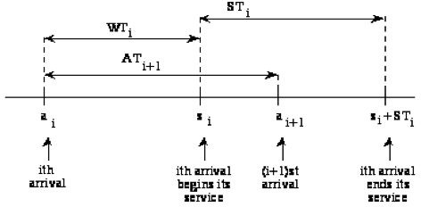
Example Single server Queue
in the simulation model of the single server queue, an arrival or a departure will change the status of the system
STi the service
Wti the waiting time of arrival
ATi+1 be the interarrival time between the ith and (i+1)st arrival
assume that the ith arrival occurs at time ai, starts its service at time si and ends its service at time si + STi,

Slide 31
Cont.
assume that we know the waiting time WTi and the service time STi of the ith customer Let ATi+1 be the inter-arrival time of the (i+1)st custom
The (i+1)st arrival occurs during the time that the ith arrival is waiting.
The (i+1)st arrival occurs when the ith arrival is in service
The (i+1)st arrival occurs after the ith arrival has departed from the queue
For each of these three cases, the waiting time WTi+1 of the (i+1)st customer can be easily determined as follows:
^{TW}_{i} is the total waiting time in the system of customer i.

Slide 32
Having calculated WTi+1, we generate a service time STi+1 for the (i+1)st arrival, and an inter-arrival time ATi+2 for the (i+2)nd arrival.
The waiting time of the (i+2)nd arival can be obtained using the above expressions.

Slide 33
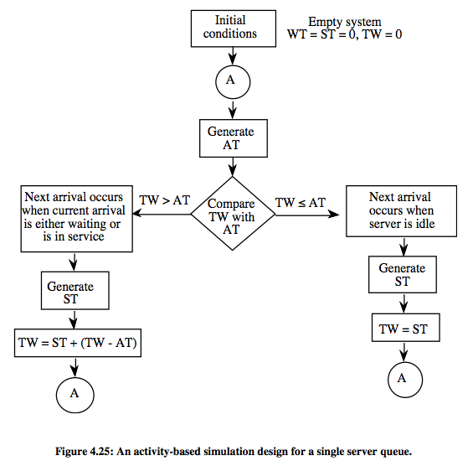

Slide 34
Examples ??
An inventory system
A round-robin queue

