Slide 1
Random Number Tests

Slide 2
Load balancing (computing)
Load balancing is a computer networking method for distributing workloads across multiple computing resources, such as computers, a computer cluster, network links, central processing units or disk drives. Load balancing aims to optimize resource use, maximize throughput, minimize response time, and avoid overload of any one of the resources.

Slide 3
Round-robin DNS
An alternate method of load balancing, which does not necessarily require a dedicated software or hardware node, is called round robin DNS
In this technique, multiple IP addresses are associated with a single domain name;
clients are expected to choose which server to connect to.
Unlike the use of a dedicated load balancer, this technique exposes to clients the existence of multiple backend servers. The technique has other advantages and disadvantages, depending on the degree of control over the DNS server and the granularity of load balancing desired.
Another more effective technique for load-balancing using DNS is to delegate www.example.org as a sub-domain whose zone is served by each of the same servers that are serving the web site. This technique works particularly well where individual servers are spread geographically on the Internet.

Slide 4
http://www.webopedia.com/TERM/R/Round_Robin_DNS.html
Round robin works on a rotating basis in that one server IP address is handed out, then moves to the back of the list; the next server IP address is handed out, and then it moves to the end of the list; and so on, depending on the number of servers being used. This works in a looping fashion.
Round robin DNS is usually used for balancing the load of geographically distributed Web servers. For example, a company has one domain name and three identical home pages residing on three servers with three different IP addresses. When one user accesses the home page it will be sent to the first IP address. The second user who accesses the home page will be sent to the next IP address, and the third user will be sent to the third IP address. In each case, once the IP address is given out, it goes to the end of the list. The fourth user, therefore, will be sent to the first IP address, and so forth.

Slide 5
Sources

Slide 6
In Donald Knuth’s book, The Art of Computer Programming
Seminumerical Algorithms, Volume 2, he describes several empirical tests which include the:
frequency,
serial,
gap,
poker,
coupon collector's,
permutation,
run,
maximum-of-t,
collision,
birthday spacings, and
serial correlation.
http://www-cs-faculty.stanford.edu/~knuth/taocp.html

Slide 7
The DIEHARD suite of statistical tests developed by George Marsaglia
birthday spacings,
overlapping permutations,
ranks of 31x31 and 32x32 matrices,
ranks of 6x8 matrices,
monkey tests on 20-bit Words,
monkey tests OPSO,
OQSO,
DNA,
count the 1's in a stream of bytes,
count the 1's in specific bytes,
parking lot,
minimum distance,
random spheres,
squeeze,
overlapp­ ing sums,
runs, and
craps.
http://stat.fsu.edu/~geo/diehard.html

Slide 8
:::::::::::::::::::::::::::::::::::::::::::::::::::::::::::::::::::
:: This is the BIRTHDAY SPACINGS TEST ::
:: Choose m birthdays in a year of n days. List the spacings ::
:: between the birthdays. If j is the number of values that ::
:: occur more than once in that list, then j is asymptotically ::
:: Poisson distributed with mean m^3/(4n). Experience shows n ::
:: must be quite large, say n>=2^18, for comparing the results ::
:: to the Poisson distribution with that mean. This test uses ::
:: n=2^24 and m=2^9, so that the underlying distribution for j ::
:: is taken to be Poisson with lambda=2^27/(2^26)=2. A sample ::
:: of 500 j's is taken, and a chi-square goodness of fit test ::
:: provides a p value. The first test uses bits 1-24 (counting ::
:: from the left) from integers in the specified file. ::
:: Then the file is closed and reopened. Next, bits 2-25 are ::
:: used to provide birthdays, then 3-26 and so on to bits 9-32. ::
:: Each set of bits provides a p-value, and the nine p-values ::
:: provide a sample for a KSTEST. ::
:::::::::::::::::::::::::::::::::::::::::::::::::::::::::::::::::::

Slide 9
:::::::::::::::::::::::::::::::::::::::::::::::::::::::::::::::::::
:: THE OVERLAPPING 5-PERMUTATION TEST ::
:: This is the OPERM5 test. It looks at a sequence of one mill- ::
:: ion 32-bit random integers. Each set of five consecutive ::
:: integers can be in one of 120 states, for the 5! possible or- ::
:: derings of five numbers. Thus the 5th, 6th, 7th,...numbers ::
:: each provide a state. As many thousands of state transitions ::
:: are observed, cumulative counts are made of the number of ::
:: occurences of each state. Then the quadratic form in the ::
:: weak inverse of the 120x120 covariance matrix yields a test ::
:: equivalent to the likelihood ratio test that the 120 cell ::
:: counts came from the specified (asymptotically) normal dis- ::
:: tribution with the specified 120x120 covariance matrix (with ::
:: rank 99). This version uses 1,000,000 integers, twice. ::
:::::::::::::::::::::::::::::::::::::::::::::::::::::::::::::::::::

Slide 10
:::::::::::::::::::::::::::::::::::::::::::::::::::::::::::::::::::
:: This is the BINARY RANK TEST for 31x31 matrices. The leftmost ::
:: 31 bits of 31 random integers from the test sequence are used ::
:: to form a 31x31 binary matrix over the field {0,1}. The rank ::
:: is determined. That rank can be from 0 to 31, but ranks< 28 ::
:: are rare, and their counts are pooled with those for rank 28. ::
:: Ranks are found for 40,000 such random matrices and a chisqua-::
:: re test is performed on counts for ranks 31,30,29 and <=28. ::
:::::::::::::::::::::::::::::::::::::::::::::::::::::::::::::::::::

Slide 11
:::::::::::::::::::::::::::::::::::::::::::::::::::::::::::::::::::
:: This is the BINARY RANK TEST for 32x32 matrices. A random 32x ::
:: 32 binary matrix is formed, each row a 32-bit random integer. ::
:: The rank is determined. That rank can be from 0 to 32, ranks ::
:: less than 29 are rare, and their counts are pooled with those ::
:: for rank 29. Ranks are found for 40,000 such random matrices ::
:: and a chisquare test is performed on counts for ranks 32,31, ::
:: 30 and <=29. ::
:::::::::::::::::::::::::::::::::::::::::::::::::::::::::::::::::::

Slide 12
The Crypt-XS
Information Security Research Centre at Queensland University of Technology in Australia
frequency,
binary derivative,
change point,
runs,
sequence complexity
linear complexity.
http://www.isrc.qut.edu.au/cryptx/index.html .

Slide 13
The NIST Statistical Test Suite
requency, block frequency, cumulative sums, runs, long runs, Marsaglia's rank, spectral (based on the Discrete Fourier Transform), nonoverlapping template matchings, overlapping template matchings, Maurer's universal statistical, approximate entropy (based on the work of Pincus, Singer and Kalman), random excursions (due to Baron and Rukhin), Lempel-Ziv complexity, linear complexity, and serial.
http://www.itl.nist.gov/div893/staff/soto/jshome.html

Slide 14
Evaluation Approaches Given a binary sequence s
Case A: Threshold Values
compute a test statistic to a threshold value.
a binary sequence fails this test "whenever the value of c(s) falls below the threshold value.”
Case B: Fixed Ranges
Computing a test statistic for s as before.
s fails a test if the test statistic falls outside of a range.
800 bits ignificance level is fixed at 5%,
400 – 1.96/2*√800 = [373,427]

Slide 15
Case C: Probability Values
computing a test statistic for s and its corresponding probability value (P-value)
Typically, test statistics are constructed so that large values of a statistic suggest a non-random sequence

Slide 16
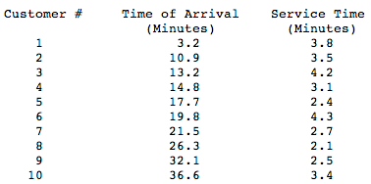
Example - Simulation of a Bank Teller
Objective is to determine the percent of time the teller is idle and the average time a customer spends at the bank

Slide 17
Manual Simulation
The manual simulation of this example corresponding to the values in the above table is summarized in the table below by customer number. It is assumed that initially there are no customers in the system, the teller is idle, and the first customer is to arrive at time 3.2.

Slide 18
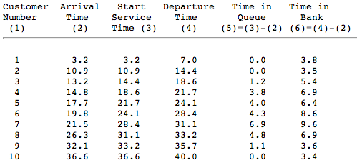

Slide 19
Average Values (expected values)
time in queue 2.61 minutes
time in bank for each customer 5.81 minutes

Slide 20
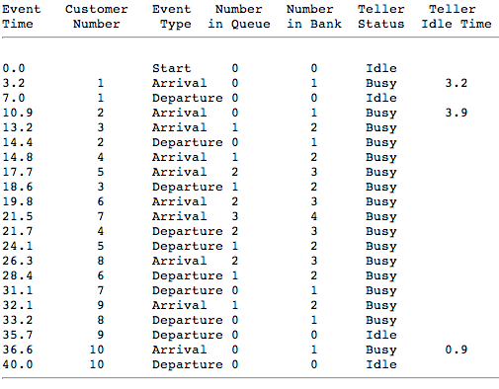

Slide 21
Results
In first 40 minutes is average customer in the bank is 1.4525 and that the teller is idle 20 percent of the time.

