Slide 1
Validation of Simulation Model

Slide 2
Important but neglected
The question is
How accurately does a simulation model (or, for that matter, any kind of model) reflect the operations of a real-life system?
How confident can we be that the obtained simulation results are accurate and meaningful?
Performance of an unimplemented system can only be measured by simulation, ex. switch
how does one make sure that the model that will be constructed is a valid representation of the system under study?
If we have the system and ımprove it
The model of the existing system can be validated by comparing its results against actual data obtained from the system under investigation

Slide 3
Check List
the pseudo-random number generators
uniformly distributed in (0,1)
satisfy statistical criteria of independence
the stochastic variate generators
Similar question should be answered for stochastic varıates
the logic of the simulation program
This is a rather difficult task
print out the status variables ,event lısts or any relevant data
Relationship validity
Quite frequently the structure of a system under study is not fully reflected down to its very detail in a simulation model
Output validity
If actual data is data we can compare the simulatıon model results

Slide 4
Variance Reduction Techniques VRT
The accuracy of an estimate is proportional to 1/√ n , where n is the sample size.
One way to increase the accuracy of an estimate increase n
To halvethe confidence interval 4n shuld be used
BUT it requires long time and expensive ( memory and cpu)
An alternative way to increasing the estimate's accuracy is to reduce its variance.
If one can reduce the variance of an endogenously created random variable without disturbing its expected value, then the confidence interval width will be smaller, for the same amount of simulation
Techniques aiming at reducing the variance of a random variable are known as Variance Reduction Techniques

Slide 5
VRT
Variance reduction techniques require additional computation in order to be implemented.
Not for sure whether a variance reduction technique will effectively reduce the variance in comparison with straightforward simulation.
Common practice is to carry out a plot experiment
a) the antithetic variates technique and
(b) the control variates technique.

Slide 6
The antithetic variates technique AVT
This is a very simply technique to use and it only requires a few additional instructions in order to be implemented
No general guarantee of its effectiveness can be given
Therefore, a small pilot study may be useful in order to decide whether or not to implement this technique.

Slide 7
AVT
Let X be an endogenously created random variable
realizations of X obtained in a simulation run.
observations of X obtained in a second simulation run.
Now, let us define a new random variable

Slide 8
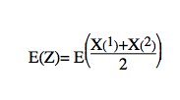
AVT cont.
More specifically, let indicates the random variable X as observed in the ith simulation run. We have
Thus, the expected value of this new random variable Z is identical to that of X. Now, let us examine its variance. We have

Slide 9
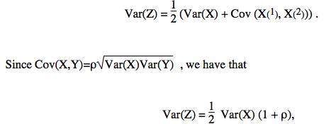
AVT
where ρ is the correlation between X(1) and X(2)

Slide 10
AVT
In order to construct an interval estimate of E(X), we use random variable Z.
we can cause Var(Z) to become significantly less than Var(X). This is achieved by causing ρ to become negative.
In the special case where the two sets of observations X1 and X2 are indipendent of each other we have that p=0 hence Var(Z)=Var(X)/2
The antithetic variates technique attempts to introduce a negative correlation between the two sets of observations.

Slide 11
Example
As an example, let us consider a simulation model of a single server queue, and let X and Y indicate the waiting time in the queue and the interarrival time respectively.
If Y is very small, then customers arrive faster and, therefore, the queue size gets larger.
The larger the queue size, the more a customer has to wait in the queue, i.e. X is larger.
On the other hand, if Y is large, then customers arrive slower and, hence, the queue size gets smaller. Obviously, the smaller the queue size, the less a customer has to wait in the queue, i.e., X is small.
Therefore, we see that X and Y can be negatively correlated.

Slide 12
Example Cont.
This negative correlation between these two variables can be created in a systematic way as follows.
Let F(t) and G(S) be the cumulative distribution of the inter- arrival and service time respectively
Let ri and vi be pseudo-random numbers.
Then, ti=F⁻¹(ri) andsi=G⁻¹(vi) are an interarrival and a service variate. These two variates can be associated with the ith simulated customer
An indication of whether the queue is tending to increase or decrease can be obtained by considering the difference di=ti-si.
This difference may be positive or negative indicating that the queue is going through a busy or slack period respectively

Slide 13
Ex. Contrast
Now, let us consider that in the second run, we associate pseudo-random number r’i and v’i with the ith simulated customer, so that below equation has the opposite sign of di.
That is, if the queue was going through a slack (busy) period in the first run at the time of the ith simulated customer, now it goes through a busy (slack) period
It can be shown that this can be achieved by simply setting r’i = 1-ri and v’i =1-vi.

Slide 14
We make use of two controllable variables, Y1 and Y2, indicating the interarrival time and the service time respectively.
These two random variables are strongly correlated with X, the waiting time in the queue.
Yj(1) and Yj(2), j=1,2 can be negatively correlated by simply using the compliment of the pseudo-random numbers used in the first run.

Slide 15
Implementing technique
Simulate the single server queue, and let , x₁ ⁽¹⁾, x₂⁽¹⁾, ..., x_{n}⁽¹⁾ be n i.i.d observations of X. (
Re-run the simulation, thus replicating the results, using pseudo-random numbers (ri,vi)=(1-r,1-vi). Let x₁ ⁽²⁾, x₂⁽²⁾, ..., x_{n}⁽²⁾ be realization of X. Construct the interval estimate of E(X) using random variable z as described above.
Obviously, the correlation between the two samples of observations is as good as the correlation between Y1j and Yj2, j=1,2.
Independent and identically distributed

Slide 16
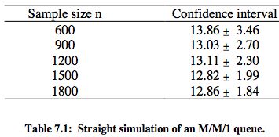
implemented in simulation of an M/M/1 queue
The random variable X is the time a customer spends in the system
The i.i.d. observations of X were obtained by sampling every 10th customer.
Using the antithetic variates technique, we obtained a confidence interval of 13.52±1.76
antithetic variates techniques were employed using two sets of observations each of size equal to 300, i.e., a total of 600 observations.

Slide 17
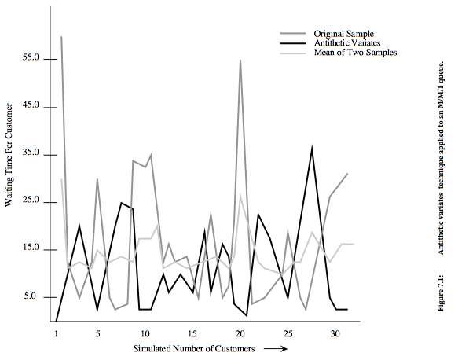

Slide 18
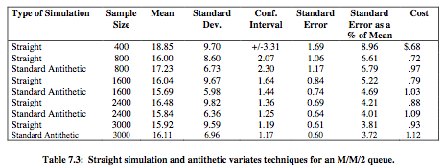
In the above example, the antithetic variates technique worked quite well. However, this should not be construed that this method always works well.
In particular, in the following example, an M/M/2 queuing system was simulated

Slide 19
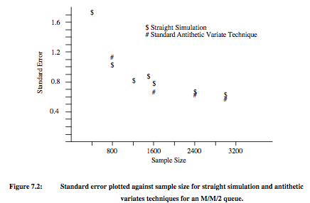

Slide 20
The control variates technique
This method is otherwise known as the method of Concomitant Information.
Let X be an endogenously created random variable whose mean we wish to estimate.
Let Y be another endogenously created random variable whose mean is known in advance known as the control variable.
Random variable Y is strongly correlated with X.

Slide 21
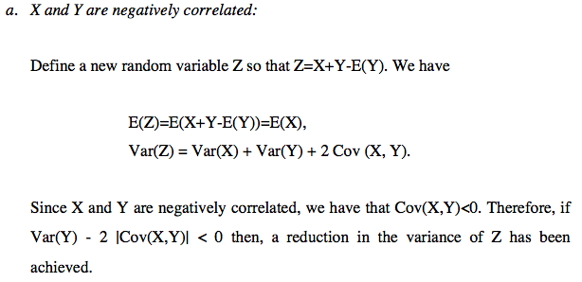

Slide 22
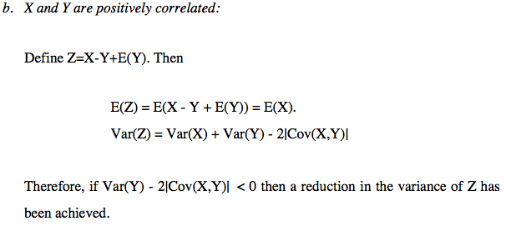

Slide 23
Example example of a single server queue
Let X be the time a customer spends in the system Then X is negatively correlated with the random variable Y representing the inter-arrival time. (It is also positively correlated with the random variable representing the service time.)
Let x1, x2, ..., xn be n i.i.d. observations of X
Likewise, let y1, y2, ..., yn be n observations of Y
yi is the inter-arrival time associated with the xi observation.

Slide 24
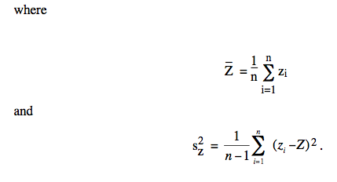
Cont.
confidence interval for the estimate of E(X) using

Slide 25
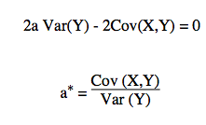
a
where a is a constant to be estimated and Y is positively or negatively correlated to X
Again, we have E(Z)=E(X)
so that Z has a smaller variance than X if
We select a so that to minimize the right-hand side given in the above expression

Slide 26
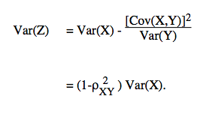
Cont.
Now, substituting into the expression for Var(Z) we have
Thus, we always get a reduction in the variance of Z for the optimal value of a, provided that X and Y are correlated
The determination of a* requires a priori knowledge of the Var(Y) and Cov (X,Y)
The definition of Z can be further generalized using multiple control variables, as follows

Slide 27
Cont.
where ai, i=1,2,...,m, are any real numbers. In this case,

