Slide 1
Thread ++ JAVA
Dr. Mustafa Cem Kasapbaşı

Slide 2
What is Thread in java?
Threads consumes CPU in best possible manner, hence enables multi processing. Multi threading reduces idle time of CPU which improves performance of application.
Thread are light weight process.
A thread class belongs to java.lang package.
We can create multiple threads in java, even if we don’t create any Thread, one Thread at least do exist i.e. main thread.
Multiple threads run parallely in java.
Threads have their own stack.
Advantage of Thread : Suppose one thread needs 10 minutes to get certain task, 10 threads used at a time could complete that task in 1 minute, because threads can run parallely.

Slide 3
What is difference between Process and Thread in java?
One process can have multiple Threads,
Thread are subdivision of Process. One or more Threads runs in the context of process. Threads can execute any part of process. And same part of process can be executed by multiple Threads.
Processes have their own copy of the data segment of the parent process while Threads have direct access to the data segment of its process.
Processes have their own address while Threads share the address space of the process that created it.
Process creation needs whole lot of stuff to be done, we might need to copy whole parent process, but Thread can be easily created.
Processes can easily communicate with child processes but interprocess communication is difficult. While, Threads can easily communicate with other threads of the same process using wait() and notify() methods.
In process all threads share system resource like heap Memory etc. while Thread has its own stack.
Any change made to process does not affect child processes, but any change made to thread can affect the behavior of the other threads of the process.

Slide 4
What is significance of using Volatile keyword?
Java allows threads to access shared variables. As a rule, to ensure that shared variables are consistently updated, a thread should ensure that it has exclusive use of such variables by obtaining a lock that enforces mutual exclusion for those shared variables.
If a field is declared volatile, in that case the Java memory model ensures that all threads see a consistent value for the variable.
Few small questions>
Q. Can we have volatile methods in java?
No, volatile is only a keyword, can be used only with variables.
Q. Can we have synchronized variable in java?
No, synchronized can be used only with methods, i.e. in method declaration.

Slide 5
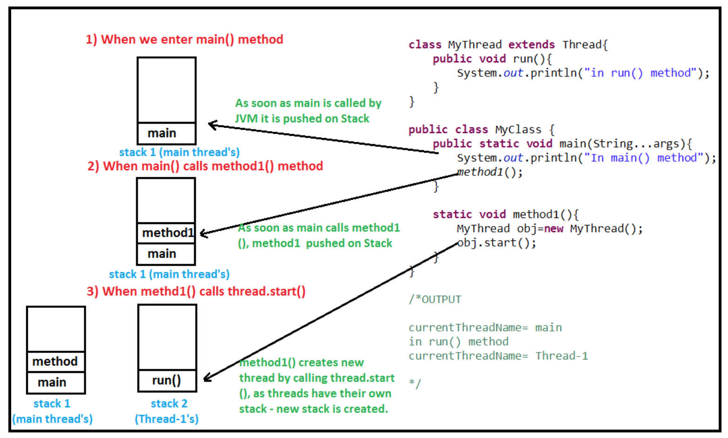
Threads have their own stack

Slide 6
Can you again start Thread?
No, we cannot start Thread again, doing so will throw runtimeException java.lang.IllegalThreadStateException. The reason is once run() method is executed by Thread, it goes into dead state.
Let’s take an example-
Thinking of starting thread again and calling start() method on it (which internally is going to call run() method) for us is some what like asking dead man to wake up and run. As, after completing his life person goes to dead state.

Slide 7
What is race condition in multithreading and how can we solve it?
When more than one thread try to access same resource without synchronization causes race condition.
So we can solve race condition by using either synchronized block or synchronized method. When no two threads can access same resource at a time phenomenon is also called as mutual exclusion.
READing of a resource by multiple thread without synchronization does not cause Problem BUT Writing DOES

Slide 8
How threads communicate between each other?
Threads can communicate with each other by using wait(), notify() and notifyAll()methods.

Slide 9
Race Conditions and Critical Sections
A race condition is a special condition that may occur inside a critical section. A critical section is a section of code that is executed by multiple threads and where the sequence of execution for the threads makes a difference in the result of the concurrent execution of the critical section.
When the result of multiple threads executing a critical section may differ depending on the sequence in which the threads execute, the critical section is said to contain a race condition. The term race condition stems from the metaphor that the threads are racing through the critical section, and that the result of that race impacts the result of executing the critical section.

Slide 10
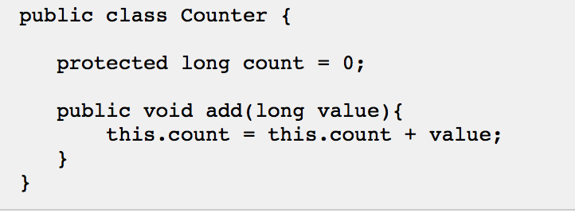
Critical Sections
Running more than one thread inside the same application does not by itself cause problems. The problems arise when multiple threads access the same resources. For instance the same memory (variables, arrays, or objects), systems (databases, web services etc.) or files.
In fact, problems only arise if one or more of the threads write to these resources. It is safe to let multiple threads read the same resources, as long as the resources do not change.

Slide 11
Imagine if two threads, A and B, are executing the add method on the same instance of the Counterclass. There is no way to know when the operating system switches between the two threads. The code in the add() method is not executed as a single atomic instruction by the Java virtual machine. Rather it is executed as a set of smaller instructions, similar to this:
Read this.count from memory into register.
Add value to register.
Write register to memory.
Observe what happens with the following mixed execution of threads A and B:

Slide 12
Race Conditions in Critical Sections
The code in the add() method in the example earlier contains a critical section. When multiple threads execute this critical section, race conditions occur.
More formally, the situation where two threads compete for the same resource, where the sequence in which the resource is accessed is significant, is called race conditions. A code section that leads to race conditions is called a critical section.

Slide 13
Preventing Race Conditions
To prevent race conditions from occurring you must make sure that the critical section is executed as an atomic instruction. That means that once a single thread is executing it, no other threads can execute it until the first thread has left the critical section.
Race conditions can be avoided by proper thread synchronization in critical sections. Thread synchronization can be achieved using a synchronized block of Java code. Thread synchronization can also be achieved using other synchronization constructs like locks or atomic variables like java.util.concurrent.atomic.AtomicInteger.

Slide 14
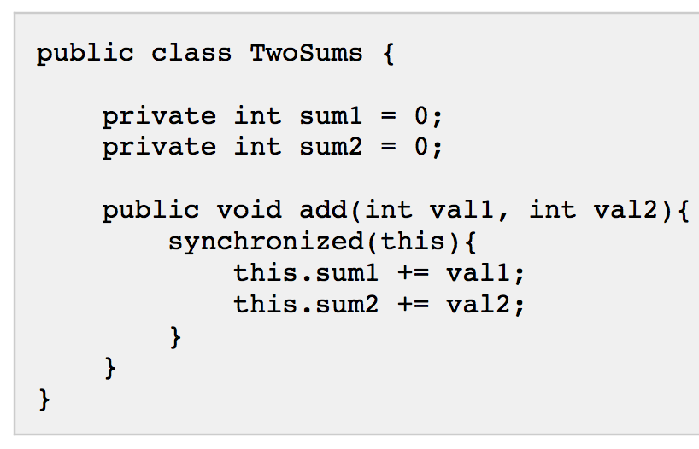
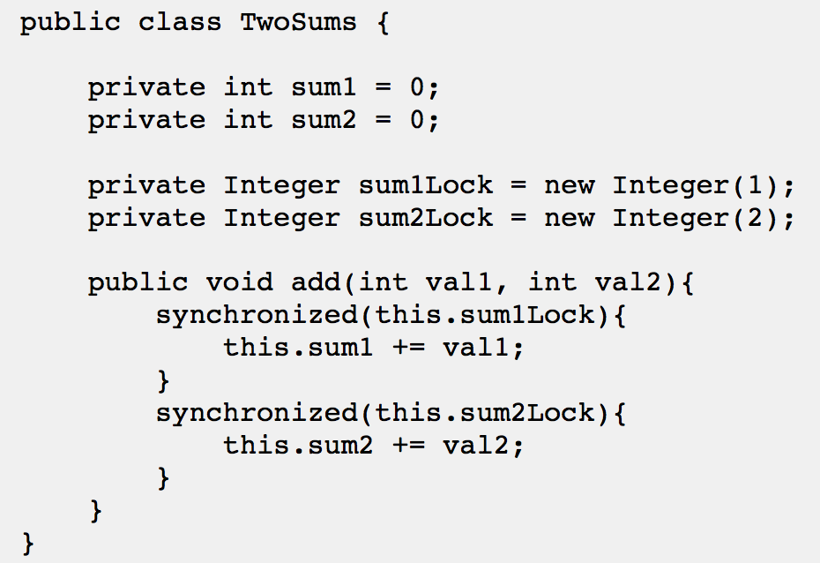
Critical Section Throughput
For smaller critical sections making the whole critical section a synchronized block may work. But, for larger critical sections it may be beneficial to break the critical section into smaller critical sections, to allow multiple threads to execute each a smaller critical section. This may decrease contention on the shared resource, and thus increase throughput of the total critical section.
Here is a very simplified Java code example to show what I mean:

Slide 15
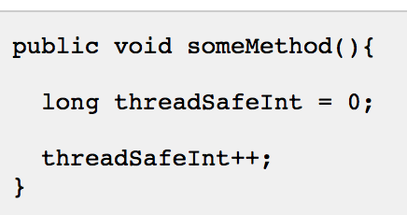
Thread Safety and Shared Resources
Code that is safe to call by multiple threads simultaneously is called thread safe. If a piece of code is thread safe, then it contains no race conditions. Race condition only occur when multiple threads update shared resources. Therefore it is important to know what resources Java threads share when executing.
Local Variables
Local variables are stored in each thread's own stack. That means that local variables are never shared between threads. That also means that all local primitive variables are thread safe.

Slide 16
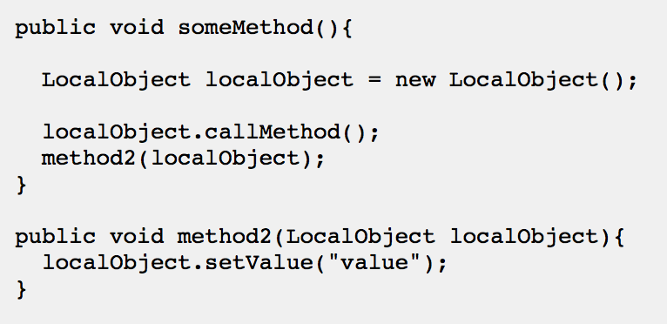
Thread Safety and Shared Resources
Local Object References
Local references to objects are a bit different. The reference itself is not shared. The object referenced however, is not stored in each threads's local stack. All objects are stored in the shared heap.
If an object created locally never escapes the method it was created in, it is thread safe. In fact you can also pass it on to other methods and objects as long as none of these methods or objects make the passed object available to other threads.

Slide 17
Thread Safety and Shared Resources
Object Member Variables
Object member variables (fields) are stored on the heap along with the object. Therefore, if two threads call a method on the same object instance and this method updates object member variables, the method is not thread safe. Here is an example of a method that is not thread safe:

Slide 18
References
https://dzone.com/articles/threads-top-80-interview
http://tutorials.jenkov.com/java-concurrency/race-conditions-and-critical-sections.html
https://www.journaldev.com/1034/java-blockingqueue-example

Slide 19
LAB PRODUCER CONSUMER
BlockingQueue
ArrayBlockingQueue,
LinkedBlockingQueue,
PriorityBlockingQueue,
SynchronousQueue
put(E e): This method is used to insert elements to the queue. If the queue is full, it waits for the space to be available.
E take(): This method retrieves and remove the element from the head of the queue. If queue is empty it waits for the element to be available.

Slide 20
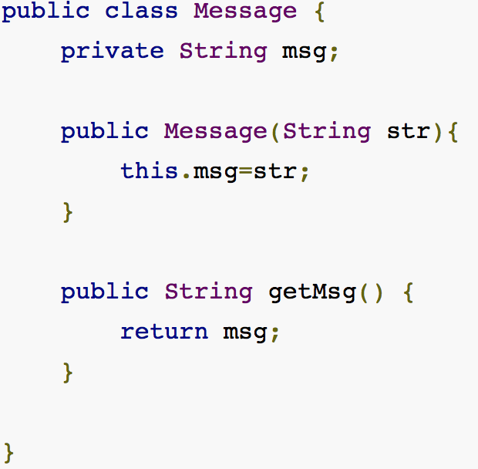
The Message

Slide 21
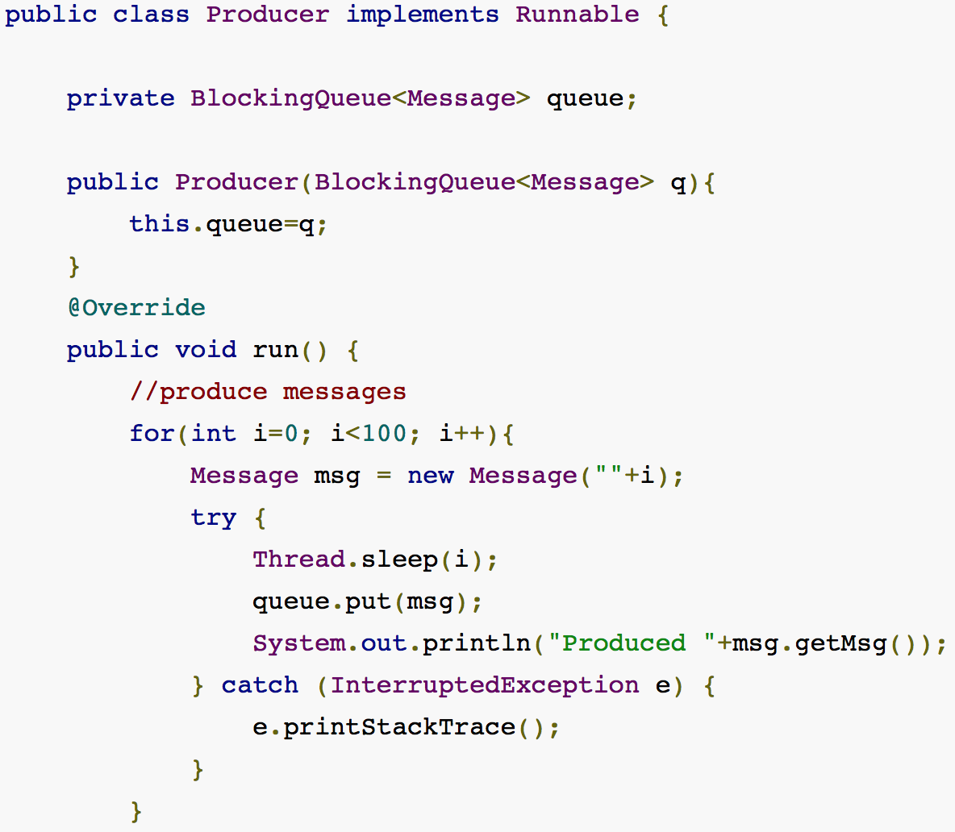
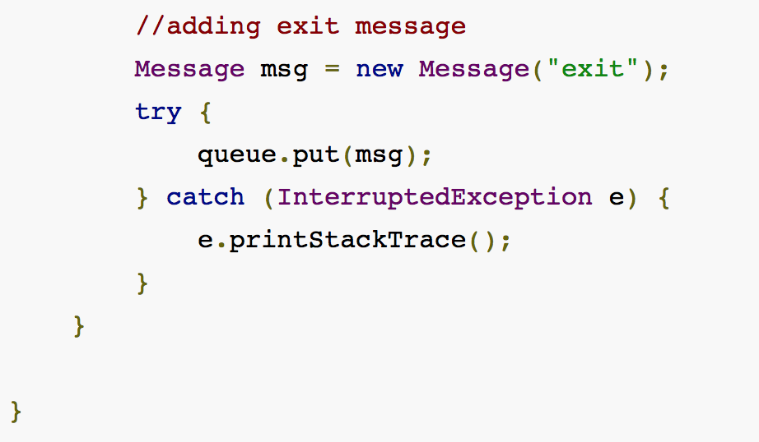
The Producer

Slide 22
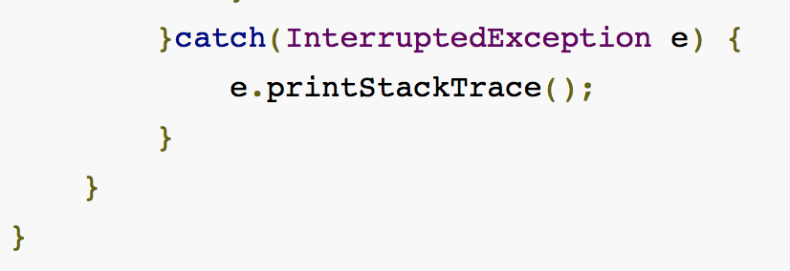
Consumer

Slide 23
