Slide 1
Notification

Slide 2
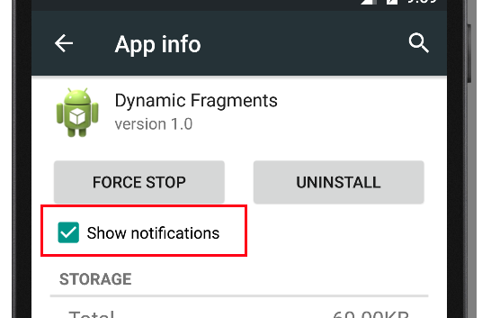
Preventing Notification
Select Apps in the Settings, select the app you are interested in and unset the Show notifications checkbox to prevent the app to show notifications.

Slide 3
Setting up Notifications
Notification class
NotificationManager class which can be received from the Context, e.g. an activity or a service, via the () getSystemService
Notification.Builder provides an builder interface to create an Notification object.
use a PendingIntent to specify the action which should be performed once the user select the notification.

Slide 4
The Notification.Builder allows you to add up to three buttons with definable actions to the notification.

Slide 5
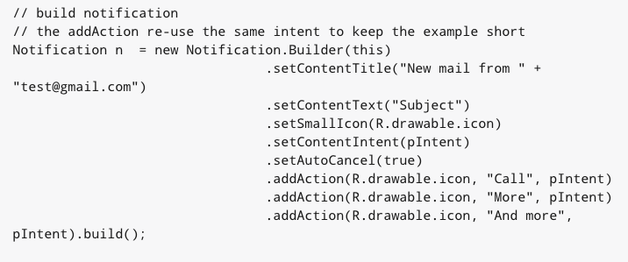

Slide 6
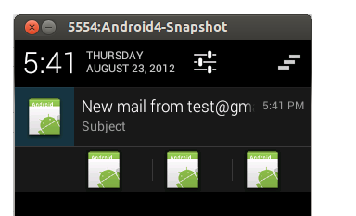

Slide 7
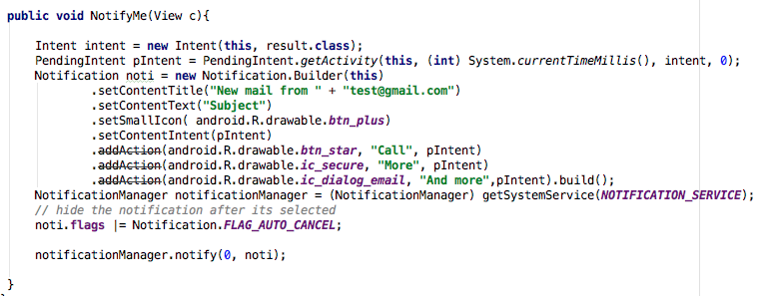

Slide 8
Scheduling tasks
If you have a repetitive task in your Android app, you need to consider that activities and services can be terminated by the Android system to free up resources. Therefore you can not rely on standard Java schedule like the TimerTasks class.

Slide 9
Options for scheduling
The (outdated) AlarmManager
the JobScheduler API.

Slide 10
JobScheduler to schedule background jobs
The Android 5.0 Lollipop (API 21) release introduces a job scheduler API via the JobScheduler class
In general this API can be used to schedule everything that is not time critical for the user.

Slide 11
Compared to a custom SyncAdapter or the alarm manager,
the JobScheduler supports batch scheduling of jobs.
The Android system can combine jobs so that battery consumption is reduced.
JobManager makes handling uploads easier as it handles automatically the unreliability of the network. It also survives application restarts.

Slide 12
Tasks that should be done once the device is connect to a power supply
Tasks that require network access or a Wi-Fi connection.
Task that are not critical or user facing
Tasks that should be running on a regular basis as batch where the timing is not critical

Slide 13
JobInfo
A unit of work is encapsulated by a JobInfo object.

